Slide 1
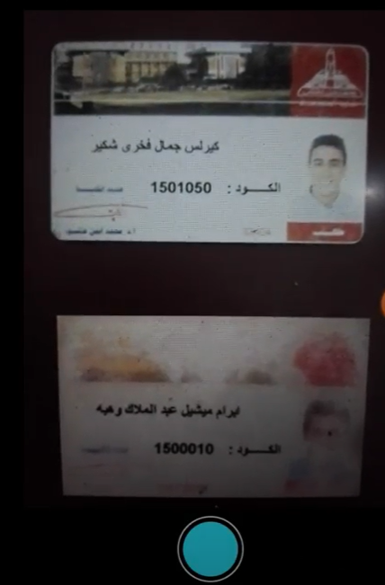
How to use the application:
3. Take photo that include IDs.
This image will be sent to the server.

Slide 2
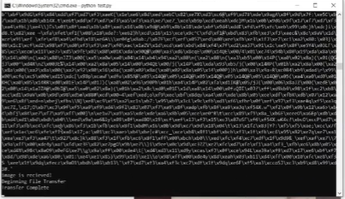
Information of the image will
be sent to server.
Server will scan the image , extract IDs and convert them to
text.
open file(list.txt) and write the IDs on it.
Server will send that file(list.txt)
which content the IDs to client.

Slide 3
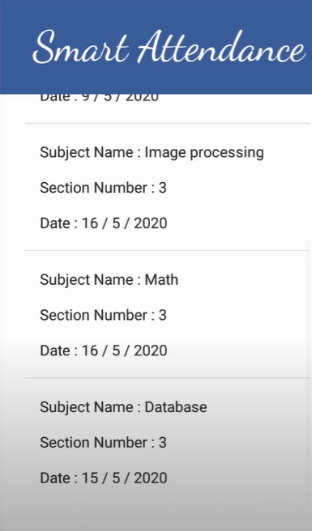
How to use the application:
Then subject name ,section number and date will appear in view existing section.

Slide 4
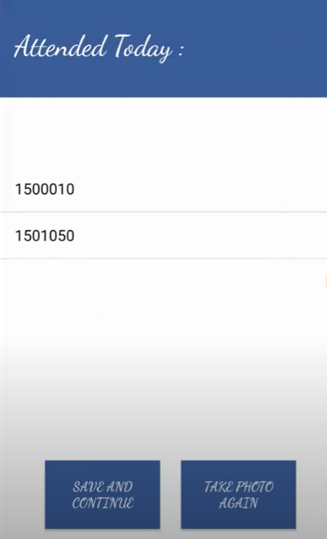

How to use the application:
Then the IDs of student will be
recorded as shown

Slide 5

How to use the application:
the application allow the user to take more than one picture this is done by choosing take another image and enter the expected IDs in the next picture.

Slide 6


The End

